Slide 1
Chongqing University of Technology
ATAI
Advanced Technique of Artificial Intelligence
Chongqing University of Technology
Code:None
Heterogeneous Graph Structure Learning for Graph Neural Networks
Jianan Zhao,1,2 Xiao Wang,1 Chuan Shi,1y Binbin Hu,3 Guojie Song,4 Yanfang Ye2
1 School of CS, Beijing University of Posts and Telecommunications, Beijing, China
2 Department of CDS, Case Western Reserve University, OH, USA
3 Ant Group
4 Key Laboratory of Machine Perception, Ministry of Education, Peking University
jxz1244@case.edu, fxiaowang, shichuang@bupt.edu.cn,
bin.hbb@antfin.com, gjsong@pku.edu.cn, yanfang.ye@case.edu
Code : https://github.com/Andy-Border/HGSL
AAAI_2021
Reported by Xinsheng Wang

Slide 2
Chongqing University of Technology
ATAI
Advanced Technique of Artificial Intelligence
Chongqing University of Technology
1.Introduction
2.Method
3.Experiments

Slide 3
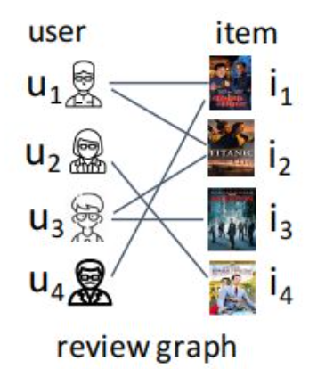
Introduction
网上例子

Slide 4
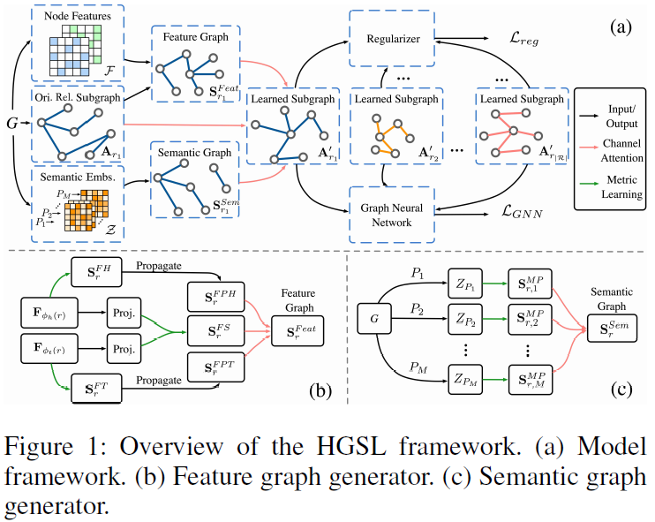
Method

Slide 5
Method
Feature Graph Generator
Feature Similarity Graph
Feature Propagation Graph

Slide 6
Method
Semantic Graph Generator

Slide 7
Method
Optimization

Slide 8
Experiments

Slide 9
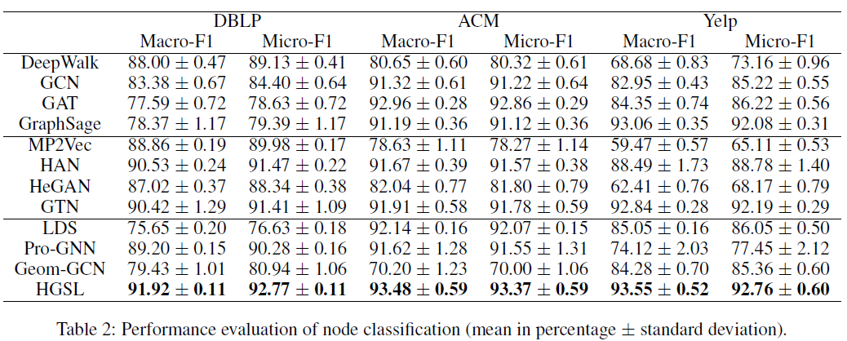
Experiments

Slide 10
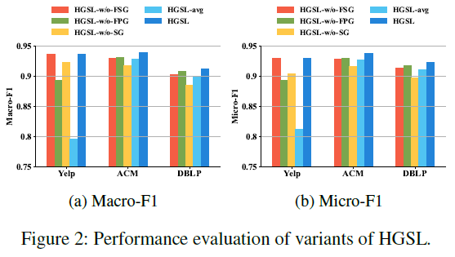
Experiments

Slide 11
Experiments

Slide 12
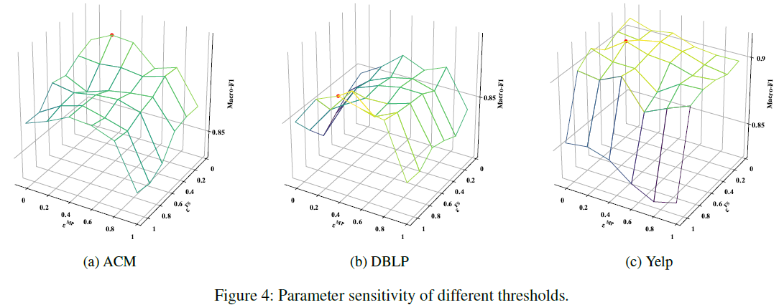
Experiments

Slide 13
Thank you!

